Slide 1
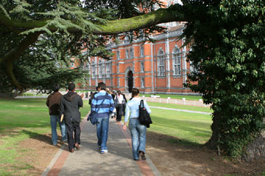
Welcome to Campus Life…..
Towards a connected campus
Notes:
Problems faced by teachers

Slide 2
In Teacher’s Mind….

Slide 3






How can I share my research work everywhere?
Better way to give assignments???
Need to share notes faster
Easy attendance tracking
Reaching all students is tiring
Notes:
Mark Attendance
Write your own educational Blogs
Assign Tasks/Assignments to Students
Make easy and quick announcements
Share notes and file with respective classes
Get Recommended based on your activity
Get followed by students at national level
Share knowledge by creating forums
Get National recognition

Slide 4
In Student’s Mind….

Slide 5
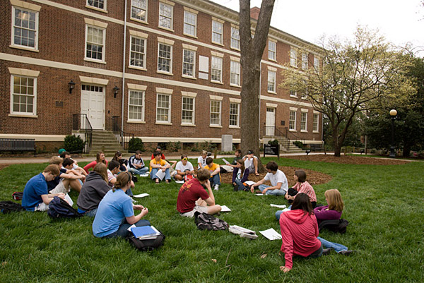
How can I be a part of National Level Organisatons?
How can I measure my skills?
I want to participate in National Level Fests
I have a brilliant project in mind. But need a team
I need a better way to promote our college fest
I need to check social n/w
Notes:
Calendar
Task Management
Educational Blogging
Join Organisations at a National Level
Meet people with similar interests
Keep updated with events across the country
Share your knowledge with others
Build great projects together
Promote your events
Follow teachers and other students Nationally

Slide 6

What to do?????

Slide 7



Slide 8

Let’s Campufi
the Campus

Slide 9
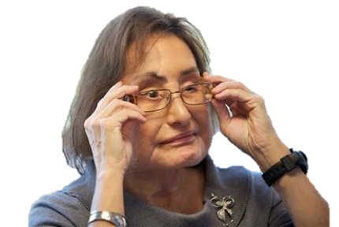

NOW, WHAT IS THIS????

Slide 10
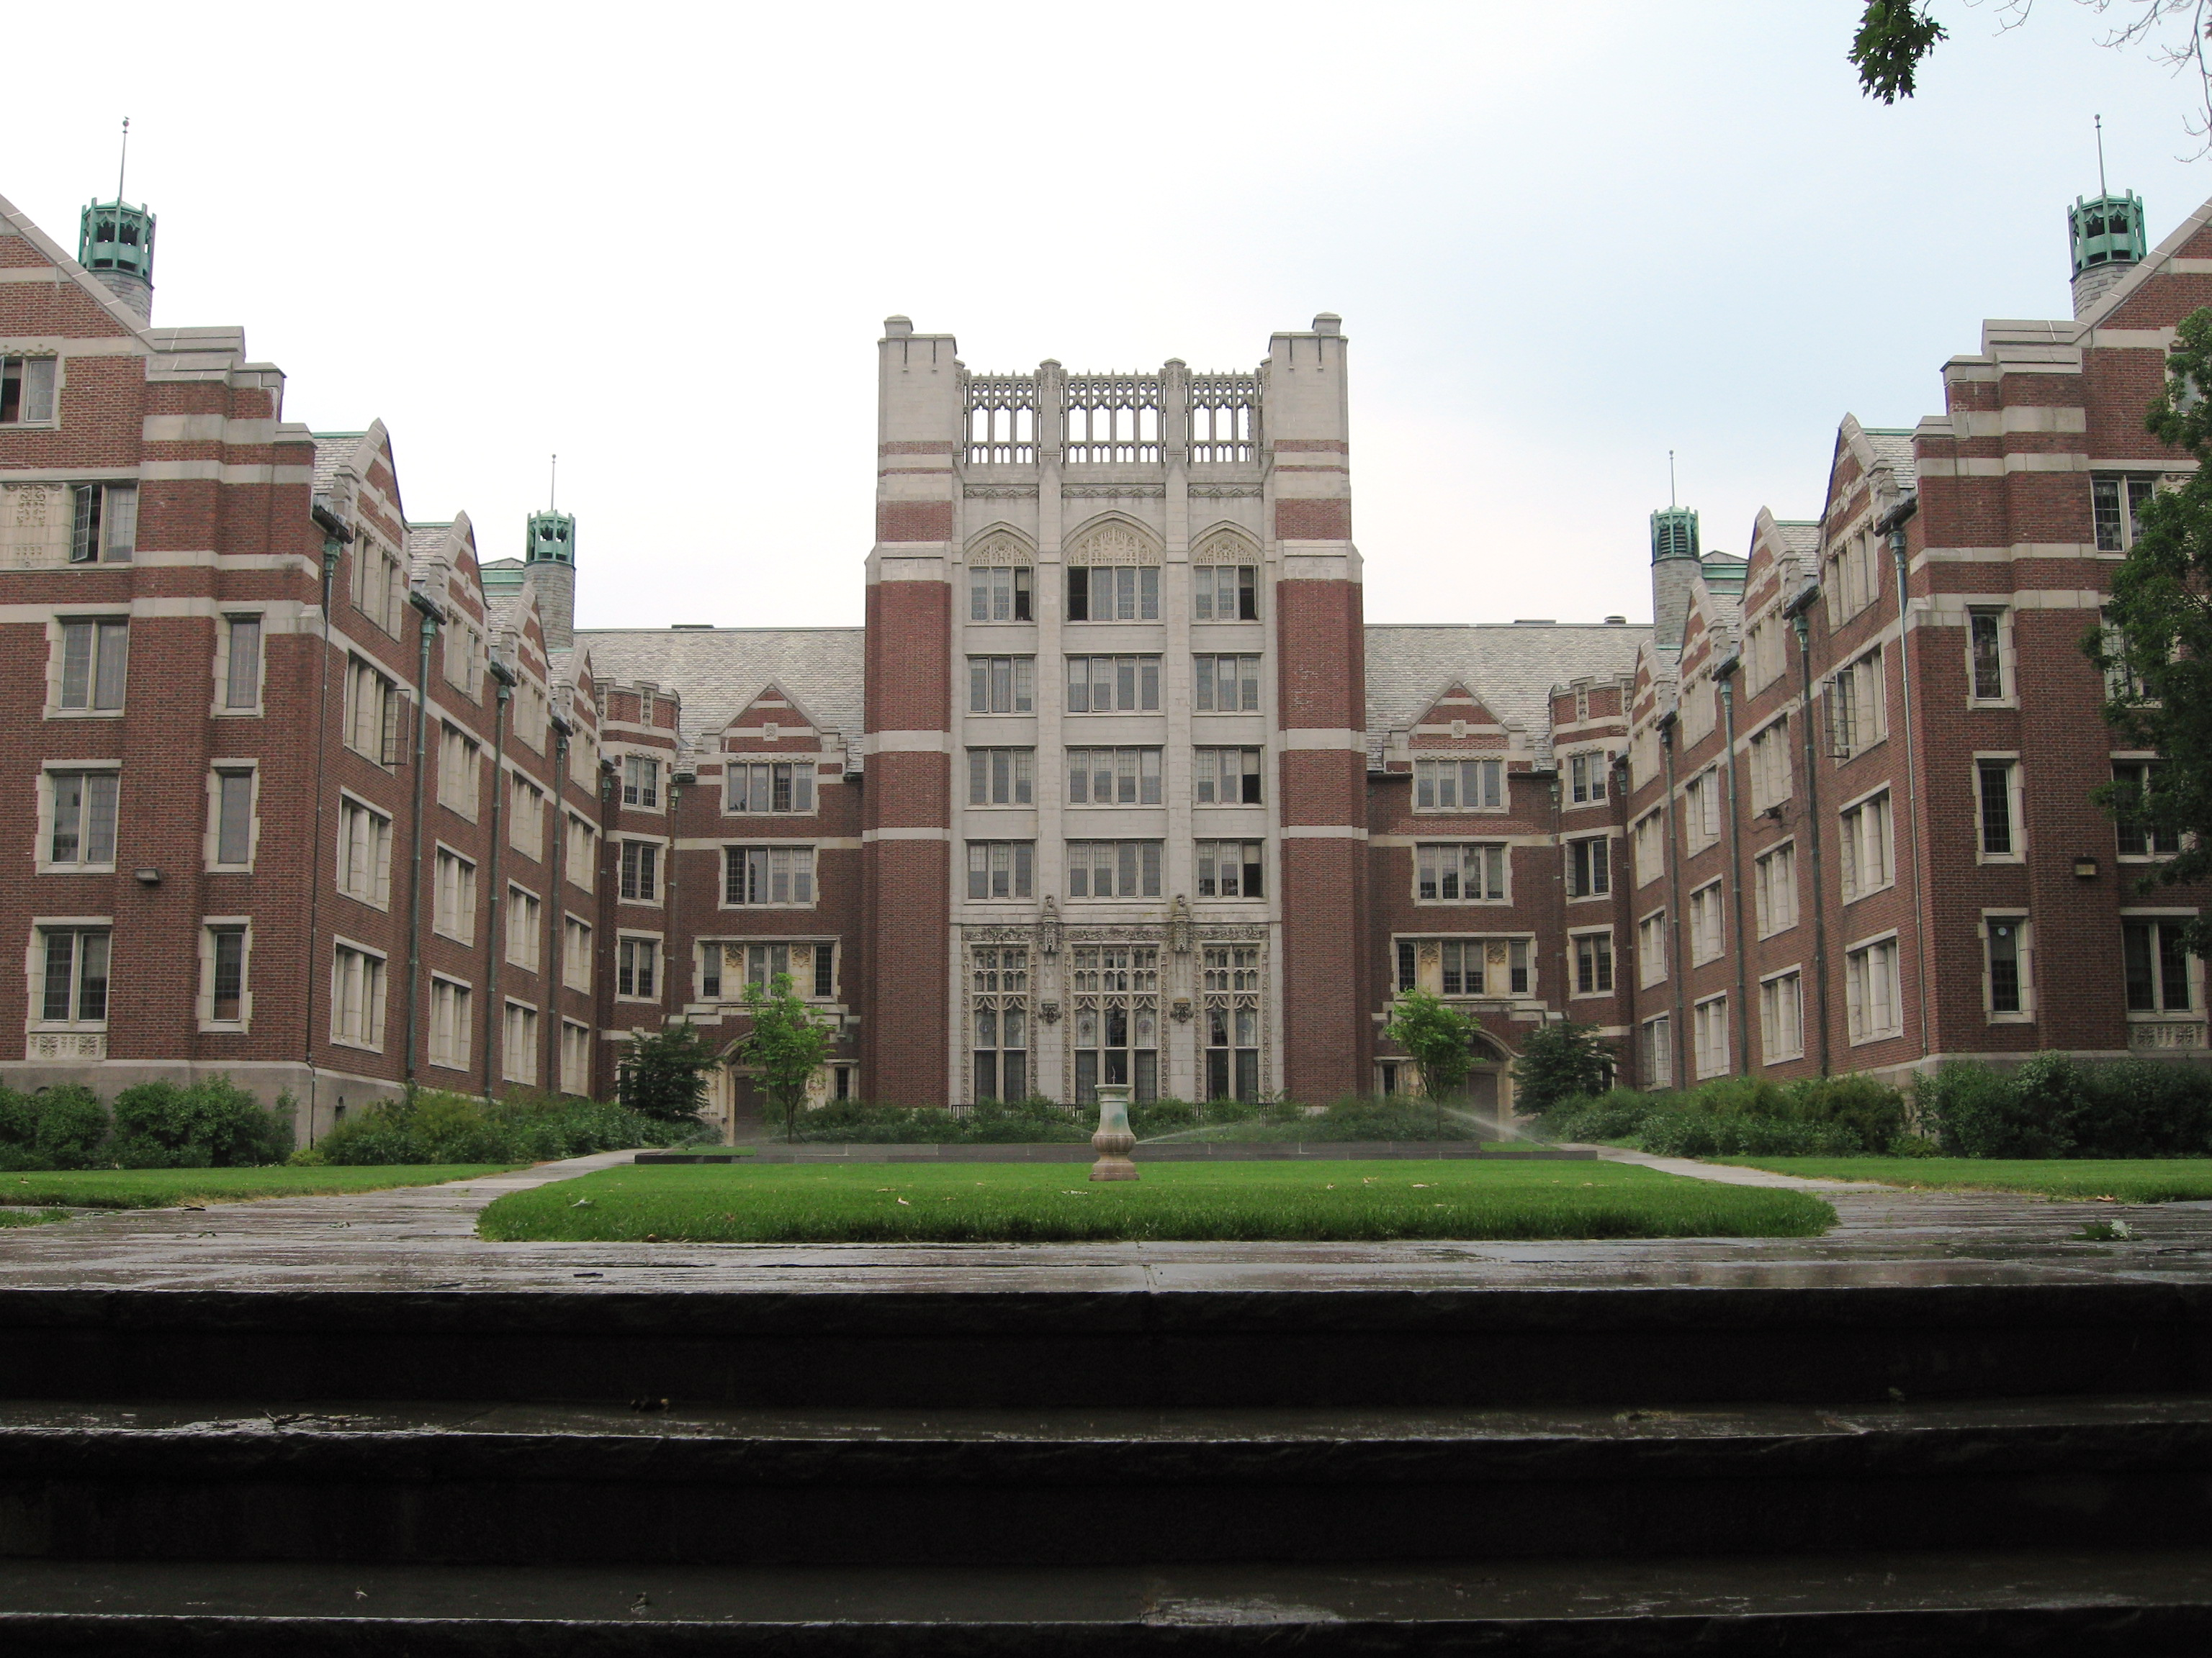








Notes:
Internal Communication of a campus
Build National Level organisations and Events
Meet people with similar interests
Skill development
Recognitions for teachers and student
Know what’s going on at other colleges
E-CVs
Teachers recognition
Paperless Work
Performance Metrics
Mock Semester Exams for students

Slide 11
“Less than 19% of the engineers are employable, only 18% actually get a job”
-Aspiring Minds Survey, 2014

Slide 12

For TEachers
MARK ATTENDANCE
WRITE YOUR OWN EDUCATIONAL BLOGS
ASSIGN TASKS/ASSIGNMENTS TO STUDENTS
MAKE EASY AND QUICK ANNOUNCEMENTS
SHARE NOTES AND FILE WITH RESPECTIVE CLASSES
GET RECOMMENDED BASED ON YOUR ACTIVITY
GET FOLLOWED BY STUDENTS AT NATIONAL LEVEL
SHARE KNOWLEDGE BY CREATING FORUMS
GET NATIONAL RECOGNITION
MAINTAIN ALL SHARED DATA

Slide 13

For STUDENTS
CALENDAR
TASK MANAGEMENT
EDUCATIONAL BLOGGING
FIND OUT what's HAPPENING IN OTHER CAMPUS
MEET PEOPLE WITH SIMILAR INTERESTS
KEEP UPDATED WITH EVENTS ACROSS THE COUNTRY
SHARE YOUR KNOWLEDGE WITH OTHERS
BUILD GREAT PROJECTS TOGETHER
PROMOTE YOUR EVENTS
FOLLOW TEACHERS AND OTHER STUDENTS NATIONALLY

Slide 14
For CAMPUS
PAN INDIA VISIBILITY
BETTER PLACEMENTS
REACH MORE STUDENTS
IMPROVED RESEARCH
BETTER PROFESSORS
EASY COMMUNICATION
CLOUD STORAGE
BETTER RECORD KEEPING
PROMOTION OF EVENTS
VISIBILITY TO COMPANIES

Slide 15

ORGANISATIONS
LEAD NATIONAL LEVEL ORGANISATIONS
CONNECTING NATIONAL LEVEL ORGANISATONS
CONNECT WITH SIMILAR INTEREST STUDENTS
EVENTS
FORUMS
BLOGS
FORMS
POLLS
FILE SHARING
MEETUPS
VOLUNTEERING
NO NON EDUCATIONAL ORGANISATIONS
ADMIN APPROVAL
ACCESS CONTROL

Slide 16


SKILL DEVELOPMENT
LEADERSHIPS
PARTICIPATION
ACTIVITY
VOLUNTEER
MOCK TESTS
PERFORMANCE EVALUATION
EXPOSURE FOR ALL

Slide 17



E-CV
PRESENT YOUR ACCOMPLISHMENTS TILL DATE
COLLEGE GRADES INTEGRATION
WORK EXPERIENCE
CO-CURRICULAR ACTIVITIES
INTERESTS
CERTIFICATES AND DOCUMENTS
PROJECTS
LORs
VIDEO CV
AUTOMATIC CV GENERATION
SHARE YOUR E-CV LINK

Slide 18


GO GREEN
FEEDBACK FORMS
REGISTRATION FORMS
GENERAL FORMS
EASY ANNOUNCEMENTS WITHOUT NOTICES
NOTES SHARING
FILE SHARING
REDUCED PHOTOCOPIES

Slide 19
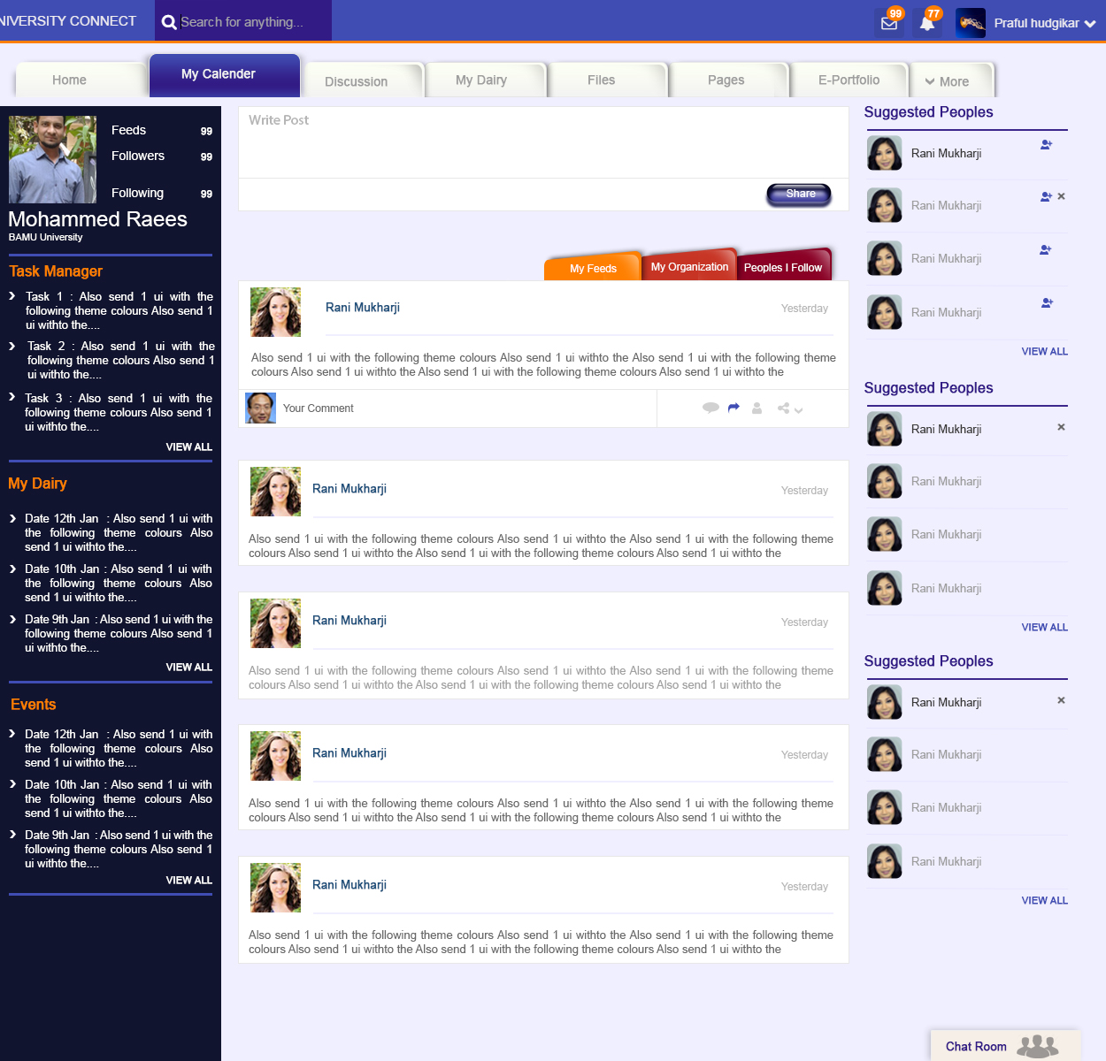
INTERNAL COMMUNICATION
ANNOUNCEMENTS
NOTES SHARING
FILES SHARING
FORMS
SMS/PUSH NOTIFICATIONS

Slide 20



Slide 21



Slide 22
c

Slide 23
Storyboard
Problems
Introduction
Solution
Users
User wise benefits
Notes:
Tes t

Slide 24
Problems
Internal Communication
Improper announcements
Difficult to reach teachers
Lack of proper skills
Why is there poor skill
No Exposure
Ignorant about events
W
Notes:
Tes t

Slide 25
What is Campufi?
College Connect is an initiative to connect the students and teachers of all colleges and bring them to a common platform, fostering skill development of its users in a competitive environment and displays the overall performance in an E-CV

Slide 26
Who are the users?
College Connect is used by the following?
Teachers
Students
HoDs
Administrators

Slide 27
What are the features
Internal Communication of a campus
Build National Level organisations and Events
Meet people with similar interests
Skill development
Recognitions for teachers and students
Know what’s going on at other colleges
E-CVs
Teachers recognition
Paperless Work
Performance Metrics
Mock Semester Exams for students

Slide 28
Internal Communication
Announcements
Notes Sharing
Files Sharing
Forms
SMS/Push Notifications

Slide 29
Creating Organisations
Lead National Level Organisations
Connecting National level organisatons
Connect with similar interest students
Events
Forums
Blogs
Forms
Polls
File Sharing
Meetups
Volunteering
No Non Educational Organisations
Admin Approval
Access Control

Slide 30
Skill Development
Leaderships
Participation
Activity
Volunteer
Mock Tests
Performance Evaluation
Exposure for all

Slide 31
What is it for Students?
Calendar
Task Management
Educational Blogging
Join Organisations at a National Level
Meet people with similar interests
Keep updated with events across the country
Share your knowledge with others
Build great projects together
Promote your events
Follow teachers and other students Nationally

Slide 32
What is it for teachers?
Mark Attendance
Write your own educational Blogs
Assign Tasks/Assignments to Students
Make easy and quick announcements
Share notes and file with respective classes
Get Recommended based on your activity
Get followed by students at national level
Share knowledge by creating forums
Get National recognition

Slide 33
E-CVs
Present your accomplishments till date
College grades integration
Work Experience
Co-curricular Activities
Interests
Certificates and Documents
Projects
LoRs
Video CV
Automatic CV generation
Share your E-CV Link

Slide 34
Paperless Work
Feedback Forms
Registration Forms
General Forms
Easy Announcements without notices
Notes sharing
File sharing
Reduced photocopies

Slide 35



